Slide 1

Exercise 2 – print to file
Using your solution from any activity (such Activity 4 or Activity 6) modify your code to create a file and log all of the output when running the program to a text file.
Your code should log all of the print statements of your program until the user has quit the application.
A new file log could be created for each instance of the run

Slide 2
Exercise 3-1 – Reading files
Using the file Artists.csv (link below) iterate through the list and print out the data in its entirety
Create some queries with the file by searching for all artists who are male and born in America (Nationality = American)
Make another query and print out all the individuals who are not American and female.
Additionally, query the file for all artists who’s begin date was before 1900 and print it to the screen
Artists.csv: https://media.githubusercontent.com/media/MuseumofModernArt/collection/master/Artists.csv

Slide 3
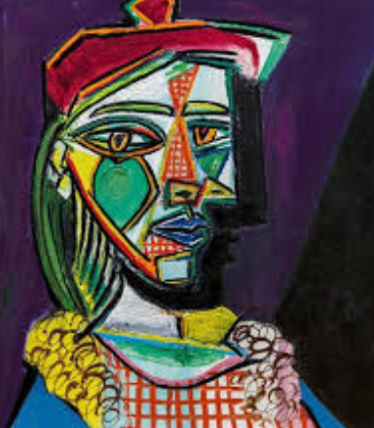
Exercise 3-2 – Reading files
Modify your code to look for lines that contain either of the following artists: Pablo Picasso or Claude Monet and print only those two lines out.
Return the two rows in a separate file called output.txt
Bonus: Remove the two above lines from Artists.csv and save the new file as Artists2.csv separately.
Artists.csv: https://media.githubusercontent.com/media/MuseumofModernArt/collection/master/Artists.csv

